Slide 1
Module 6

Slide 2
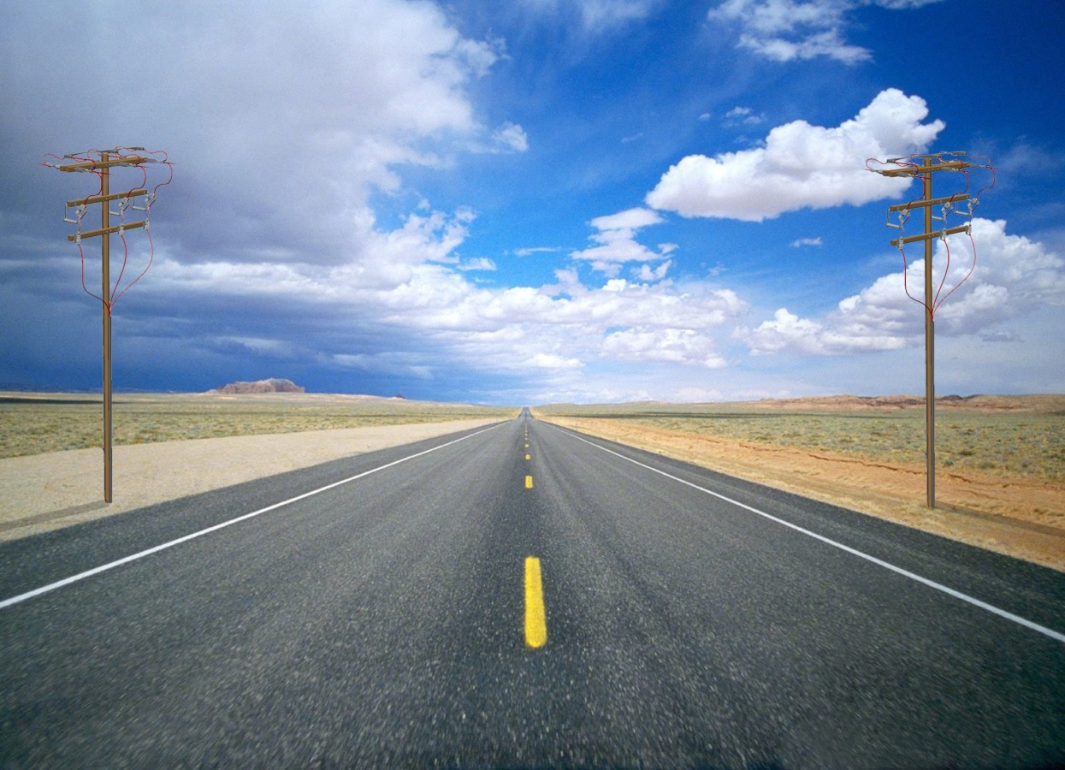
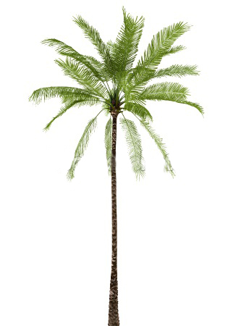


Q. A tree breaks due to storm and the broken part bends so that the
top of the tree touches the ground making an angle 30° with it.
The distance between the foot of the tree to the point where the top touches the
ground is 8 m. Find the height of the tree.
B
Note :
BC = CD
?
Point where
tree breaks
C
30º
A
8 m
D

Slide 3



B
Q. A tree breaks due to storm and the broken part b
ends so that the top of the tree touches the ground
making an angle 30° with it. The distance between
the foot of the tree to the point where the top
touches the ground is 8 m.
Find the height of the tree.
For ∠D
For ∠ADC
Ratio of Opposite side and Adjacent side reminds us of _________
Observe ∠D
AB is made up of
AC and BC
Ratio of Adjacent side and Hypotenuse reminds us of _________
Opposite side →
AC
Now let us find CD
We know that
BC = CD
Observe AB
Consider ΔCAD
Adjacent side →
AD
Observe ∠D
AB = AC + BC
Adjacent side →
AD
‘tan’
‘cos’
Hypotenuse →
CD
?
Opposite
side
C
Hypotenuse
Sol.
AB represents the height of the tree which
breaks at point C.
BC represents the length of broken part
30º
1
$$\sqrt{3}$$
D
tan 30º =
?
cos 30º =
?
A
$$\sqrt{3}$$
AC represents the length of unbroken part.
8 m
2
In right ΔCAD,
In right ΔCAD,
Adjacent side
Adjacent side
AC
AD
tan 30º
=
cos 30º
=
CD = BC
AD
CD
∴
1
AC
3
8
=
∴
=
3
8
2
BC
8
∴
3
BC
=
16
∴
AC
=
3
16
∴
BC
=
3

Slide 4

B
Q. A tree breaks due to storm and the broken part b
ends so that the top of the tree touches the ground
making an angle 30° with it. The distance between
the foot of the tree to the point where the top
touches the ground is 8 m.
Find the height of the tree.
Now, let us rationalise the denominator
16
3
C
Sol.
8
Height of tree
=
AC
+ BC
8
8
3
30º
AC
=
24
3
3
A
D
8
16
=
+
$\sqrt{3}$ = 1.73
8 m
=
3
3
3
16
BC
=
8 + 16
=
8
3
3
=
3
=
8
(1.73)
24
=
=
13.84 m
3
24
3
Height of the tree is 13.84 m
∴
Height of tree
=
×
3
3

Slide 5
Module 7 New sum to be added. Question is in R+ book

Slide 6
Module 8

Slide 7
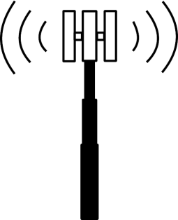
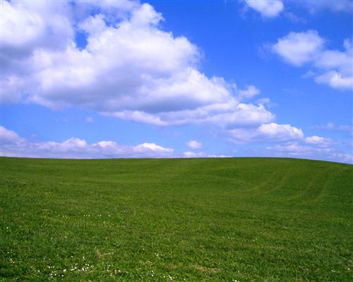


Top of
tower
C
Q. From a point on the ground, the angles of elevation
of the bottom and the top of a transmission tower
fixed at the top of a 20m high building are 45º and
60º respectively. Find the height of tower.
Transmission
Tower
?
Bottom of
tower
B
line of sight
Height of the observer is neglected
20
line of sight
60º
45º
A
D

Slide 8
From a point on the ground, the angles
of elevation of the bottom and the top
of a transmission tower fixed at the top
of a 20m high building are 45º and 60º
respectively. Find the height of tower.
C
Now, Consider ΔBAD
For ∠BDA
BC is part of AC
To find AC, first we need to find AD
Ratio of opposite side and Adjacent side reminds us of _________
?
Observe ∠D
x
Opposite side →
AB
Let us find AC
BC = AC – AB
Adjacent side →
AD
‘tan’
B
Opposite
side
Sol.
AB represents the height of the building
20
AB = 20m
BC represents the height of the
transmission tower.
60º
45º
A
D
20m
Let BC be x m
AC = AB + BC
Adjacent side
?
tan 45º =
1
In right angled ΔBAD,
∴ AC =
20
+ x
AB
tan 45º =
∴ AC =
(20 + x) m
AD
20
=
∴ 1
AD
∴ AD = 20 m

Slide 9






From a point on the ground, the angles
of elevation of the bottom and the top
of a transmission tower fixed at the top
of a 20m high building are 45º and 60º
respectively. Find the height of tower.
For ∠CDA
C
Ratio of opposite side and Adjacent side reminds us of _________
Observe ∠D
Opposite side →
AC
x
‘tan’
Adjacent side →
AD
$$\sqrt{3}$$
tan 60º =
?
Opposite
side
B
Sol.
(x +20)m
In right angled ΔCAD,
AC
20
tan 60º =
AD
AC =
(20 + x) m
60º
A
45º
D
20 + x
∴
$$\sqrt{3}$$
=
20m
20
∴
20$\sqrt{3}$
=
20 + x
Adjacent side
$\sqrt{3}$ = 1.73
∴
x
=
20$\sqrt{3}$
– 20
∴
x
=
20
($\sqrt{3}$
– 1)
∴
x
=
20
(1.73
– 1)
∴
x
=
20
× 0.73
∴
x
=
14.6
∴
Height of the transmission tower is 14.6 m

Slide 10
Module 9

Slide 11
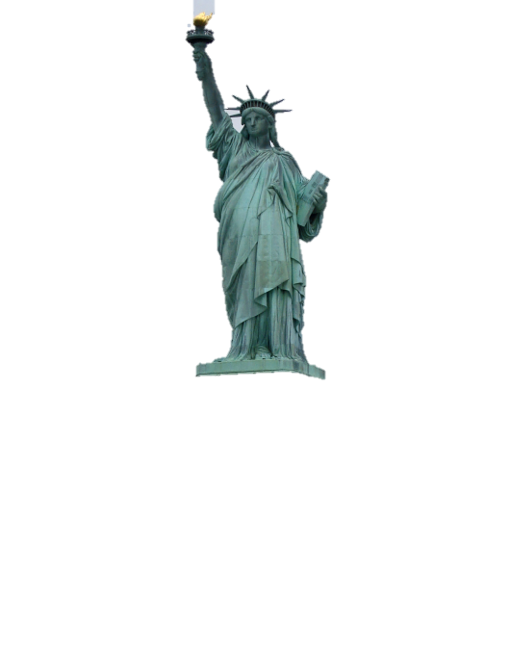
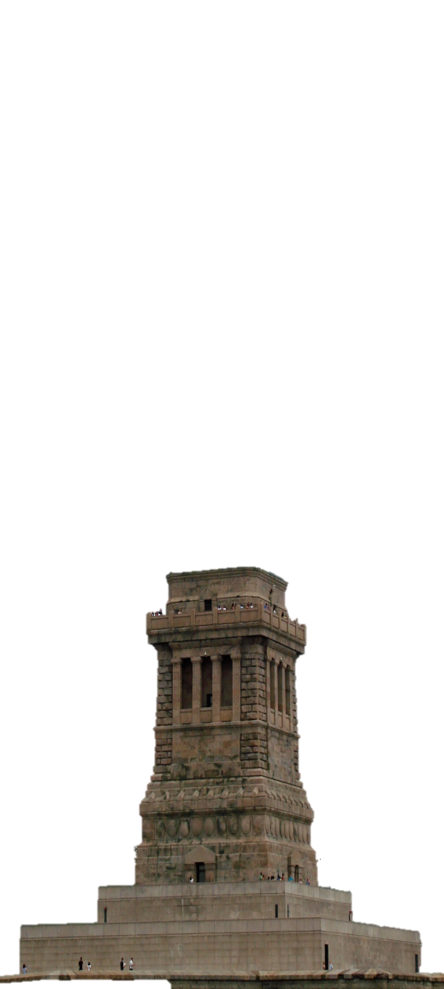

Q. A statue 1.6m tall, stands on the top of a pedestal. From a point
on the ground, the angle of elevation of the top of the statue is 60º
and from the same point angle of elevation of the top of pedestal is 45º.
Find the height of pedestal.
C
Top of statue
Statue
Height of the observer is neglected
1.6m
line of sight
B
Top of pedestal
Pedestal
line of sight
?
60º
45º
A
D

Slide 12







C
Q. A statue 1.6m tall, stands on the top of a pedestal.
From a point on the ground, the angle of elevation
of the top of the statue is 60º and from the same
point angle of elevation of the top of pedestal is 45º.
Find the height of pedestal.
For ∠CDA
For ∠BDA
Observe ∠D
Opposite
side
Observe ∠D
Ratio of opposite side and Adjacent side reminds us of _________
Ratio of opposite side and Adjacent reminds us of _________
1.6 m
Consider ΔBAD
Opposite side →
AC
Opposite side →
AB
Adjacent side →
AD
B
‘tan’
‘tan’
Adjacent side →
AD
(h + 1.6)
?
h
Sol.
Let the height of pedestal (AB) be ‘h’ m
Opposite
side
Height of statue (BC) = 1.6 m
60º
?
A
45º
D
tan 45º =
1
Let AD be x
h + 1.6
x
In right ΔBAD,
∴
$$\sqrt{3}$$
=
x
Adjacent side
Adjacent side
AB
tan 45º =
∴
$\sqrt{3}$x
=
h + 1.6
AD
$$\sqrt{3}$$
h
∴
h
=
h + 1.6
[From (i)]
∴
1
=
x
∴
$\sqrt{3}$h
– h
=
1.6
∴
x
=
h
$$\sqrt{3}$$
...(i)
tan 60º =
?
h($\sqrt{3}$ – 1)
∴
=
1.6
In right ΔCAD,
1.6
AC
∴
h
=
tan 60º =
$\sqrt{3}$ – 1
AD

Slide 13











C
Q. A statue 1.6m tall, stands on the top of a pedestal.
From a point on the ground, the angle of elevation
of the top of the statue is 60º and from the same
point angle of elevation of the top of pedestal is 45º.
Find the height of pedestal.
Now, let us rationalise the denominator by taking its conjugate
Conjugate of ($\sqrt{3}$ – 1)
is ($\sqrt{3}$ + 1)
1.6 m
B
h
Sol.
1.6
h
=
$\sqrt{3}$ = 1.73
60º
$\sqrt{3}$ – 1
A
45º
D
1.6
$\sqrt{3}$ + 1
x
∴
h
=
×
$\sqrt{3}$ – 1
$\sqrt{3}$ + 1
∴
h
=
0.8
($\sqrt{3}$ + 1)
1.6
($\sqrt{3}$ + 1)
×
∴
h
=
0.8
(1.73
∴
h
=
+ 1)
($\sqrt{3}$)²
–
(1)²
∴
h
=
0.8
(2.73)
1.6
($\sqrt{3}$ + 1)
×
∴
h
=
2.184
∴
h
=
3 – 1
0.8
∴
Height of the pedestal is 2.184 m
1.6
∴
h
=
×
($\sqrt{3}$ + 1)
2

Slide 14
Module 10 Solved Example 4

Slide 15
Thank You

